Slide 1
Succeeding with Functional-First Languages in Industry
Don Syme
F# Community Contributor (Microsoft Research)

Slide 2
F# is open source Contribute to F# open source http://fsharp.github.com Focus is on cross-platform F#

Slide 3
Some technical talks….
PDC 2008
An Overview of F# 2.0
channel9.msdn.com/blogs/pdc2008/tl11
//BUILD 2011
F# 3.0: Data, Services, Web, Cloud, at your fingertips
channel9.msdn.com/Events/BUILD/BUILD2011/SAC-904T

Slide 4
Today: Some Simple Observations About Data Engineering Analytical Programming Calculation Engines Financial Engineering….. with F# (and associated technologies)

Slide 5
I will focus on the business perspective and its correspondence to the technical features of F# Based on informal observations of >20 F# adoptions, nearly all successful some of the same lessons hold for OCaml, Erlang,, …

Slide 6
When talking about the business perspective, I will use a standard marketing methodology for selling “complex” products.
S
P
Situation
Problem
I
Implication
N
Need
TM
“SPIN Selling”, Rackham

Slide 7
Part 1 – Business Situation? Business Problems? Business Implication? Business Needs?

Slide 8
The Recurring Business Situation
“I lead a team developing…”
Financial Models
Trading Platforms
…
Insurance Calculation Engines
Bio-informatics Algorithms
Algorithmic Trading Systems
Online Recommendation Engines

Slide 9
The Recurring Business Situation
“I lead a team developing…”
Analytical Components
…
Analytical Components
Analytical Components
Analytical Components
Analytical Components

Slide 10
Understanding the Situation
Analytical Programmers
Data Engineers
Design
Code
Analysis
Algorithms
Parallel
Data
Information
Services
Presentation
Publication
UI

Slide 11
The Recurring Business Problems
Time to Market
Efficiency
Correctness
Complexity
for analytical components

Slide 12
Is Time to Market a Problem? Late Models → Missed Business Opportunities Late Services → Missed Markets Late Products → Business Failure
Notes:
“Take a moment to stop and think about the ramifications of time-to-market problems through software delays in analytical components for QF, FE, Trading and Calculation Engines more broadly”

Slide 13
Is Correctness a Problem? Buggy Models → Incorrect Values/Risks/Trades Buggy Services → Reputation Loss Buggy Products → Lost Customers
Notes:
“Take a moment to stop and think about the ramifications of correctness problems through software delays in analytical components for QF, FE, Trading and Calculation Engines more broadly”

Slide 14
Is Efficiency a Problem? Slow Models → Out-of-date Valuations/Risks Slow Services → Can’t Scale Out Slow Products → Customer Complaints
Notes:
“Take a moment to stop and think about the ramifications of efficiency problems through software delays in analytical components for QF, FE, Trading and Calculation Engines more broadly”

Slide 15
Is Complexity a Problem? Intractable Models → No product or Failed Projects Intractable Services → No product or Failed Projects Intractable Products → No product or Failed Projects
Notes:
We don’t talk enough about the software we were never able to write. We don’t talk enough about why good analytical programmers leave their jobs.

Slide 16
The Recurring Business Problems
Time to Market
Efficiency
Correctness
Complexity
for analytical components

Slide 17
What’s the Need? Analytical programmers delivering correct, efficient components in the enterprise, on-time This is the set of problems that F# helps solve

Slide 18
Part 2 - But why? The Observations

Slide 19
Observation #1 At the core of every functional-first language is this: simple, correct, robust code for complex problems

Slide 20
Observation #2 A highly interoperable language allows rapid, non-intrusive deployment and integration of components Functional code is a part of a larger solution. Your code can be rapidly integrated and deployed.

Slide 21
Observation #2 cont. Interoperable languages remove entire phases from the analytical software development process No R → C# No Mathematica → C++
Notes:
Functional programming tools empower when combined with other technologies

Slide 22
Observation #3 Strongly-typed functional languages maintain efficiency comparable to C# and Java, and sometimes C++
Notes:
Functional programming tools empower when combined with other technologies

Slide 23
Observation #4 Strongly-typed functional languages help analytical programmers tackle more complex problems
Notes:
Functional programming tools empower when combined with other technologies

Slide 24
Recap – How Functional-first Helps
Simple, correct, robust code
Interoperability eliminates entire phases
Strong-typing gives efficiency
Analytical developers empowered to solve complex problems

Slide 25
Part 2 - But why? The Examples and Case Studies

Slide 26
Example #1 (power company)
I have written an application to balance the national power generation schedule … for an energy company.
...the calculation engine was written in F#.
The use of F# to address the complexity at the heart of this application clearly demonstrates a sweet spot for the language … algorithmic analysis of large data sets.
Simon Cousins (Eon Powergen)
http://fsharp.net

Slide 27
Example #1 (power company)
Time to Market
Efficiency
Interoperation ... Seamless. The C# programmer need never know.
Units of measure … a huge time saver...it eradicates a whole class of errors…
Exploratory programming …Working with F# Interactive allowed me to explore the solution space more effectively.
Unit testing …a joy to test. There are no complex time-dependent interactions to screw things up….
Parallelism …The functional purity ... makes it ripe for exploiting the inherent parallelism in processing vectors of data.
Code reduction… … vectors and matrices…higher order functions eat these for breakfast with minimal fuss, minimal code. Beautiful.
Lack of bugs… Functional programming can feel strange. .. once the type checker is satisfied that’s often it, it works.
Correctness
Time to Market
Time to Market
Correctness
Correctness

Slide 28
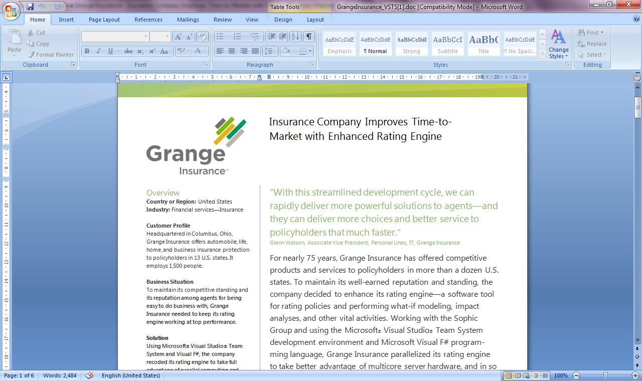
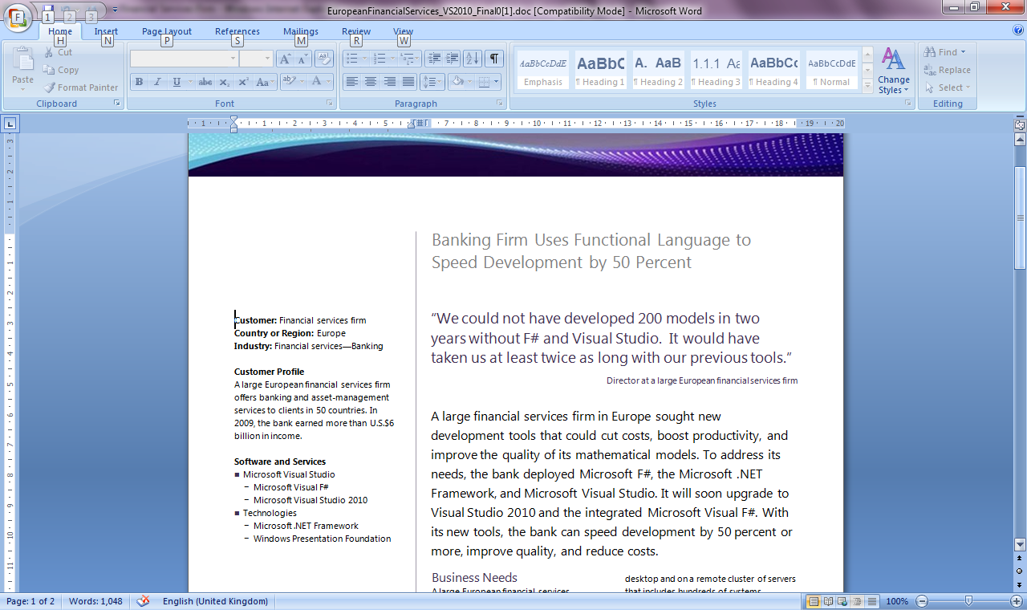
Example #2/#3: F# in Finance
Time to Market
Correctness
Time to Market
Correctness
Efficiency
http://fsharp.net

Slide 29
Example #3: F# in Insurance
I work for a large actuarial company... …Despite adopting Agile/Scrum …the usual delays, complications and sometimes …failures.
We used F#, and quickly created a system which would perform the necessary calculations highly efficiently, in parallel, and with a perfect match to the spreadsheet results.
All of the advantages which are commonly touted for F# do play out in practice. Immutability, Easy Parallelisation, Expressiveness, Testability, Conciseness, Flexibility, Productivity
[ Company name omitted ]
Time to Market
Efficiency
Correctness

Slide 30

Example #4: Finance trading platform
F# + C# for Trading Front End
Leverage F#’s features:
- extensive type system
- asynchronous workflows, agents and immutable types
- rich pattern matching and parser support
“Experienced F# developers regularly solve problems in days that would take weeks using more traditional languages…solving complex problems in an elegant and highly maintainable manner”
Time to Market
Complexity

Slide 31
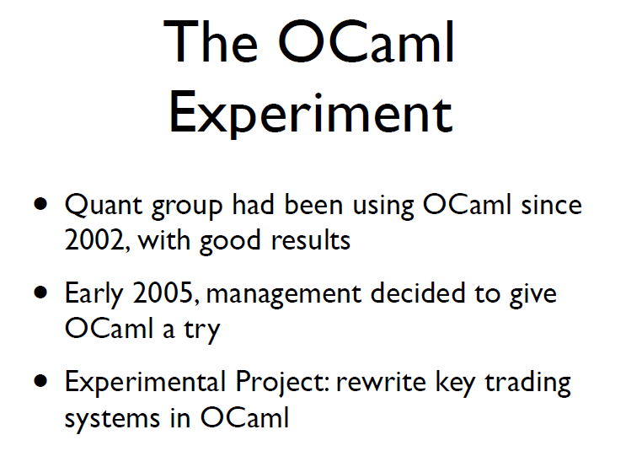
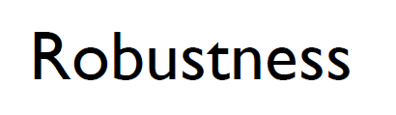
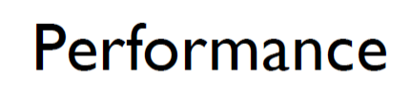
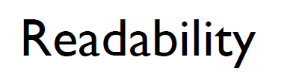
Example #5: OCaml @ Jane St
source: http://www.janestcapital.com/yaron_minsky-cufp_2006.pdf

Slide 32
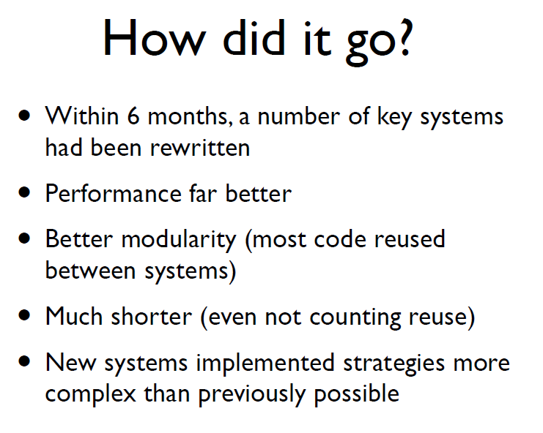
Example #5: OCaml @ Jane St
Efficiency
Solve complex problems
source: http://www.janestcapital.com/yaron_minsky-cufp_2006.pdf

Slide 33
Example #6: F# in Biotech
Efficiency
...F# rocks - building algorithms for DNA processing and it's like a drug. 12-15 at Amyris use F#... A complete genome resequencing pipeline with interface, algs, reporting in ~5K lines and it has been incredibly reliable, fast and easy to maintain.. A suffix tree in 150 lines that can index 200,000 bases a second ;)
F# v. Python: F# has been phenomenally useful. I would be writing a lot of this in Python otherwise and F# is more robust, 20x - 100x faster to run and faster to develop.
Units of measure: I started labelling the coordinates as one or zero based and immediately found a bug where I'd casually mixed the two systems. Yay F#!
Darren Platt, Amyris BioTechnologies
Correctness
Time to Market
Correctness

Slide 34
Example #7: F# in Advertisement Ranking & Rating @ Microsoft
Around 95% of the code in these projects has been developed in F#.
F# allowed for rapid development of prototypes, and thus also rapid verification or falsification of the underlying mathematical models.
Complex algorithms, for example to compute Nash equilibria in game theory, can be expressed succinctly.
Units of measure reduced the chance of errors dramatically: Prices, probabilities, derivatives, etc. can already be kept apart at compile time.
Time to Market
Taming Complexity
Correctness

Slide 35
Summary – The Data Agrees
Simple, correct, robust code
Interoperability improves time-to-market
Strong-typing gives efficiency
Analytical developers empowered to solve more complex problems

Slide 36
Part 3 – F# in Practice

Slide 37
F# 3.0 – Language Integrated Web Data
demo

Slide 38
F# 3.0 – Language Integrated Hadoop Data Scripting
demo

Slide 39
Understanding F#
F# 1.0
F# 2.0
C# (designers)
F# (code)
WebSharper/
Javascript (HTML5)
F# 3.0
Code
Analysis
Algorithms
Parallel
Data
Information
Services
Presentation
Publication
UI

Slide 40
Lesson: Combining with the right tools is key

Slide 41
Examples
A quant model
A trading engine
F# + existing C++ components
A calculation engine with GPU execution
F# + FCore Math
A scalable web service
Data Services + F# + ASP.NET
A scalable big-data service
F# + Hadoop + ServiceStack
A Web 2.0 startup
F# (Server) + SQL Server + DataFeeds + ASP.NET + F# (WebSharper) + HTML5
Oracle + F# (Server) + F#/C# (Silverlight)

Slide 42
F# in Practice: More Lessons
Build capabilities in functional-first techniques
Training is key
Trial on specific components, prototyping, testing and exploration
✗ Don’t rewrite stable, working components in F#
✗ Always reuse C++ high-performance components.

Slide 43
Recent Developments in F# @ Microsoft
F# 3.0
F# + Azure
F# + Azure Hadoop
F# + Azure Cloud Numerics
queries, powerful data integration, better tooling, portable libraries
for scalable service programming
for scalable big-data programming
for scalable math programming

Slide 44
Some Other Developments in F#
F# + WebSharper
F# + FCore
F# + m-brace
F# + …
very powerful cross-platform HTML5 web/mobile programming
for statistical/math programming + GPU
a cloud-execution framework
many other { open-source, .NET, C#, F#, … }
F# + R
R Provider for F#, access > 2000 R packages

Slide 45
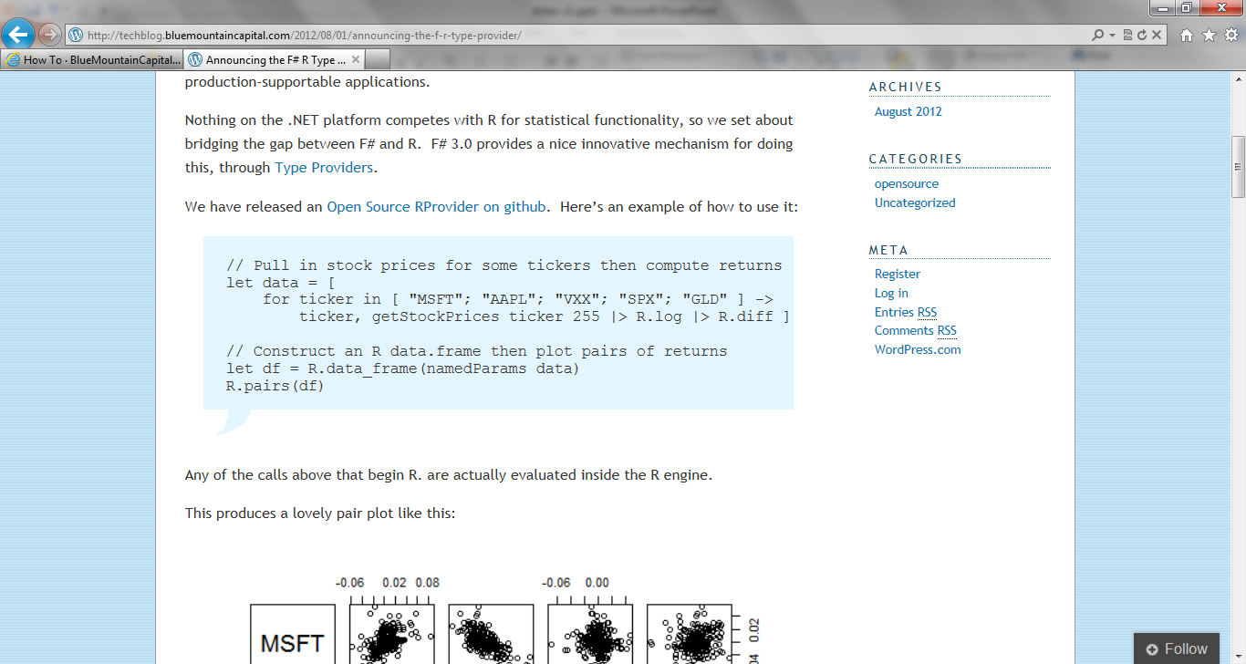
Update: RProvider
r provider f#
Open source community provider for interop with R
discovers installed R packages
access > 2,000 R packages
projects them as .NET namespaces
underneath the parent namespace RProvider

Slide 46
fsharp.github.com/fsharp
F# 3.0 compiler+library open source
Apache 2.0 license
Mac, Linux, Windows, Browsers
2.0, 4.0 profiles
Also MonoAndroid MonoTouch
fsharp.github.com/fsharp

Slide 47
In Summary – Functional-First Languages
F.F.
Rapid, correct development
Parallelism a bonus
Functional-first delivers real value
F.F. as a recruitment strategy

Slide 48
In Summary – F#
F#
Succeed with functional-first in industry today
Robust code in the modern enterprise
A bright future ahead for web/data/cloud
Open-source, cross-platform, strongly typed, supported

Slide 49
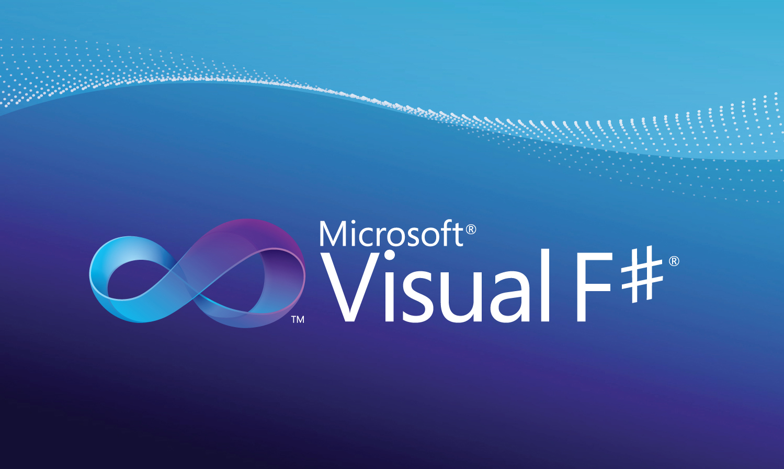
Learn more at http://fsharp.org Questions?

